Slide 1
Hand Puppets: 3D Hand Pose Prediction from Shadow Puppet Images
16-824 Course Project
Authors:
Abhishek Tandon
Gaini Kussainova
Rakshith Srinivasa Murthy Rutika Moharir

Slide 2
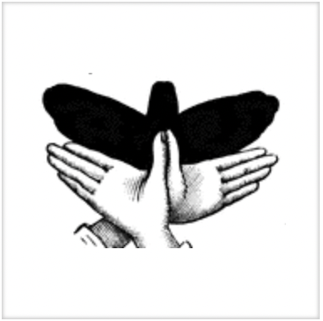
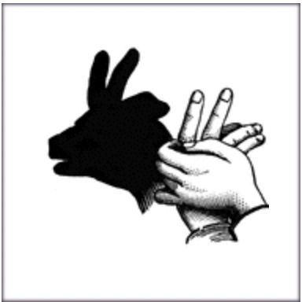
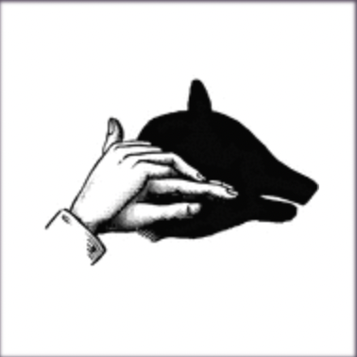
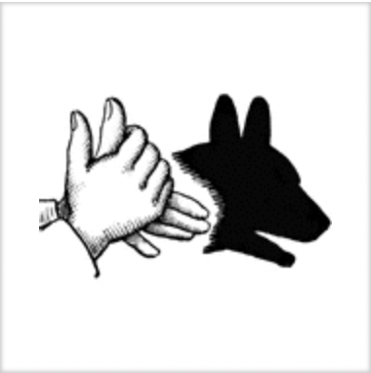
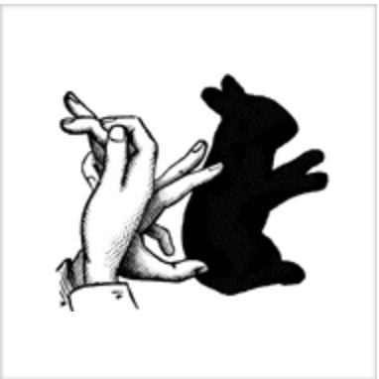
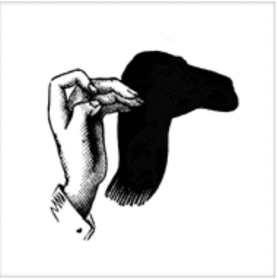
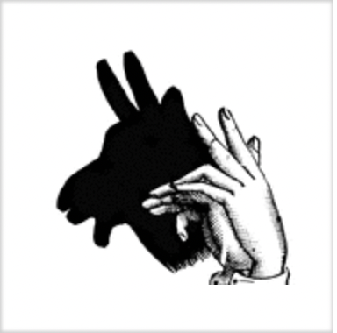
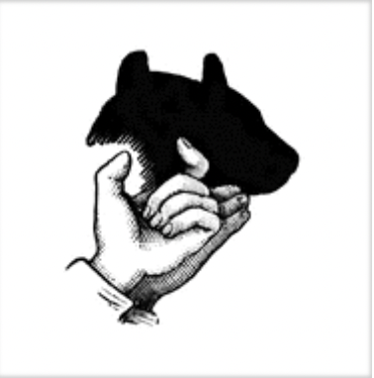
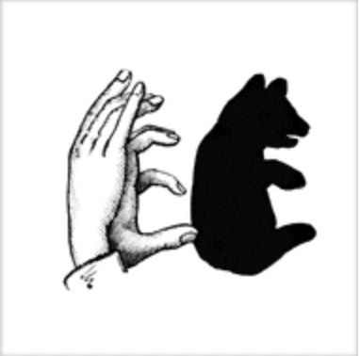
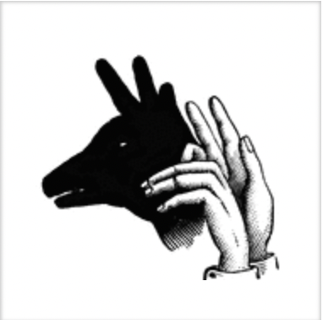
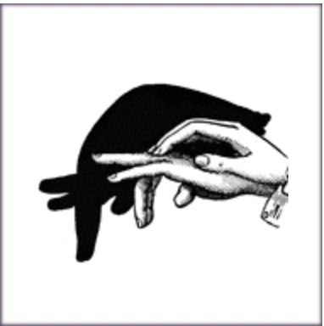
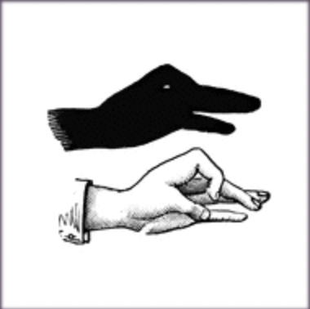
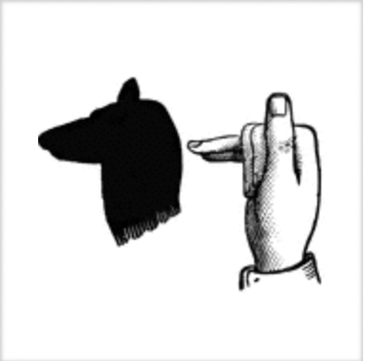
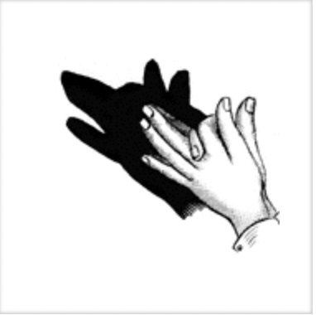
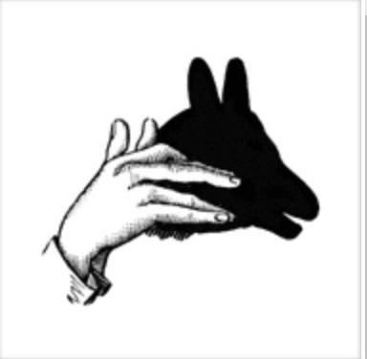
Images obtained from: https://etc.usf.edu/clipart/galleries/266-hand-shadow-puppetry

Slide 3
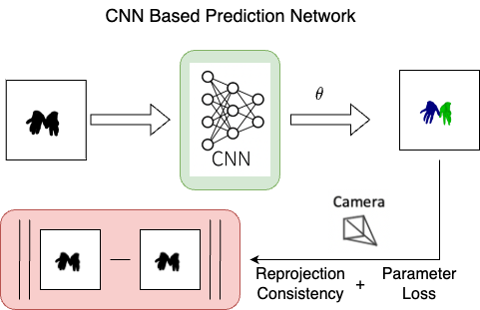
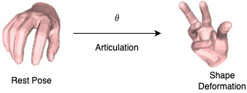
MANO Model
Proposed Task
Parameters:
Shape – Models finger slenderness and palm thickness
$β∈ℝ^{10}$
Pose – Models 3D surface deformation due to articulation
Global hand orientation $∅∈ℝ^{3}$
3D rotation of finger joint relative to the wrist, $θ∈ℝ^{3x15}$
Output:
Vertices – 3D vertices of triangulated mesh
$𝒱∈ℝ^{3x778}$
Joints – 3D joints coordinates
$J_{3D}∈ℝ^{3x42}$
Embodied Hands: Modeling and Capturing Hands and Bodies Together
Romero, Javier and Tzionas, Dimitrios and Black, Michael J..

Slide 4
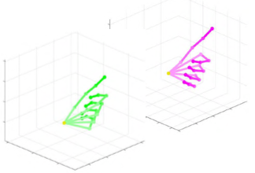
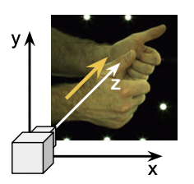
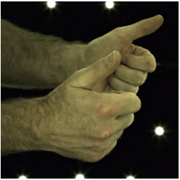
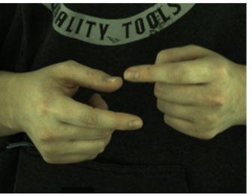
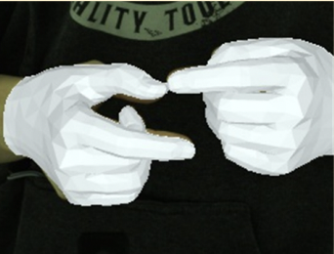
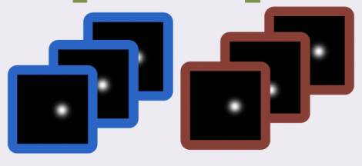
Prior Work
Outputs
Right hand exists? : yes
Left hand exists? :yes
InterNet
InterNet
Handedness: ($h_{R}, h_{L}$)
2.5D Hand Pose: ($H_{2.5D}^{R},H_{2.5D}^{L}$)
Right hand relative-left hand depth: ($z^{R →L}$)
InterHand2.6M: A Dataset and Baseline for 3D Interacting Hand Pose Estimation from a Single RGB Image, Moon, Gyeongsik and Yu, Shoou-I and Wen, He and Shiratori, Takaaki and Lee, Kyoung Mu
Hand Parameters
Encoder
Decoder
2.5D Heatmap Predict Network
Interacting Two-Hand 3D Pose and Shape Reconstruction from Single Color Image
Zhang, Baowen & Wang, Yangang & Deng, Xiaoming & Zhang, Yinda & Tan, Ping & Ma, Cuixia & Wang, Hongan.

Slide 5
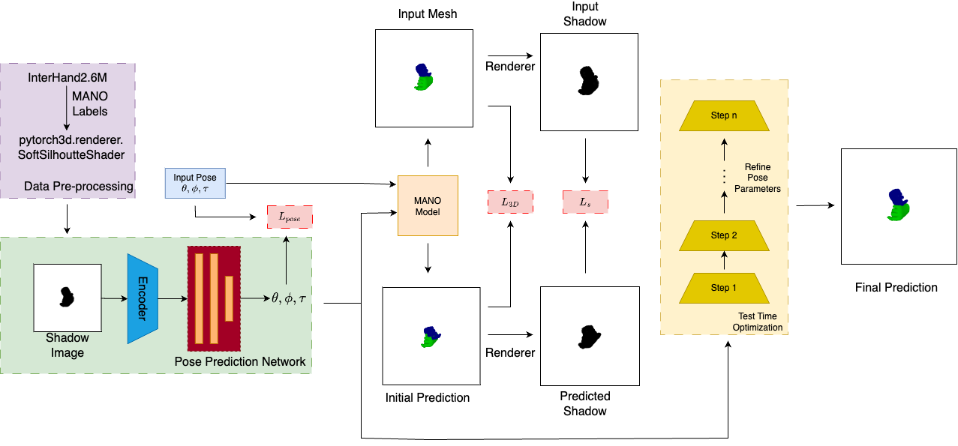
Proposed Solution

Slide 6
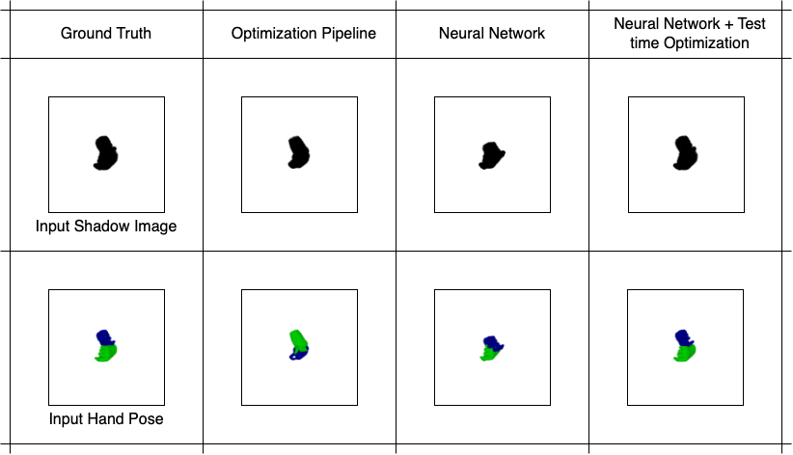
Results

Slide 7
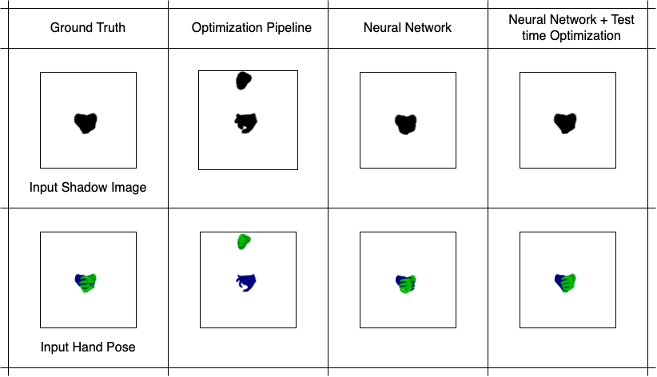
Results

Slide 8
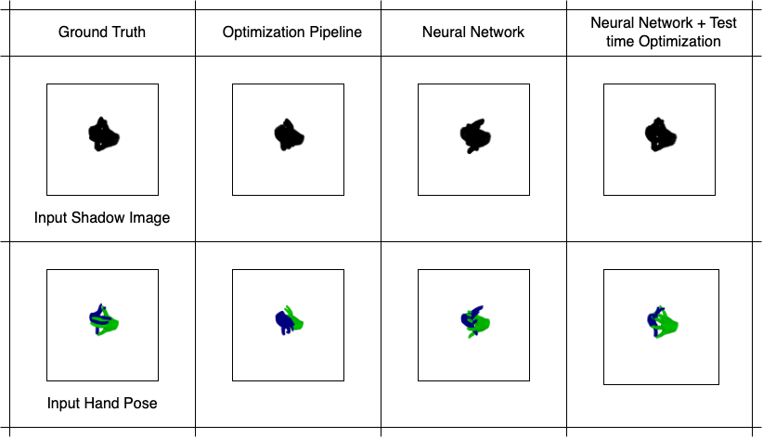
Failure Cases

Slide 9
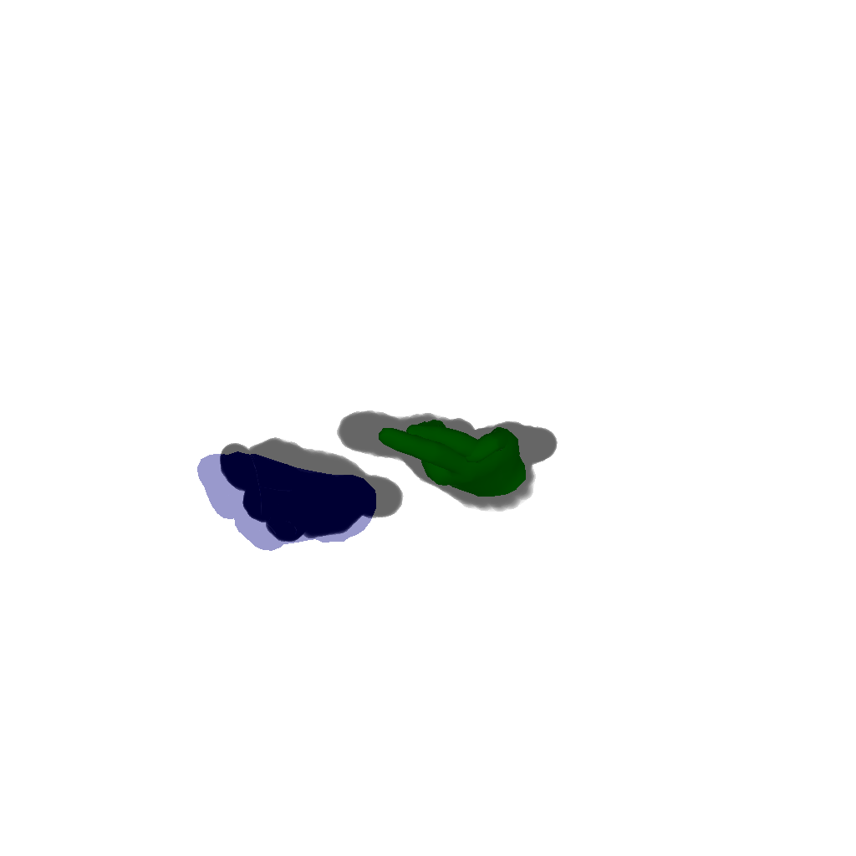
Results
Optimization Pipeline
Neural Network
Neural Network +
Test time Optimization
Neural Network +
Test time Optimization +
Temporal Input

Slide 10
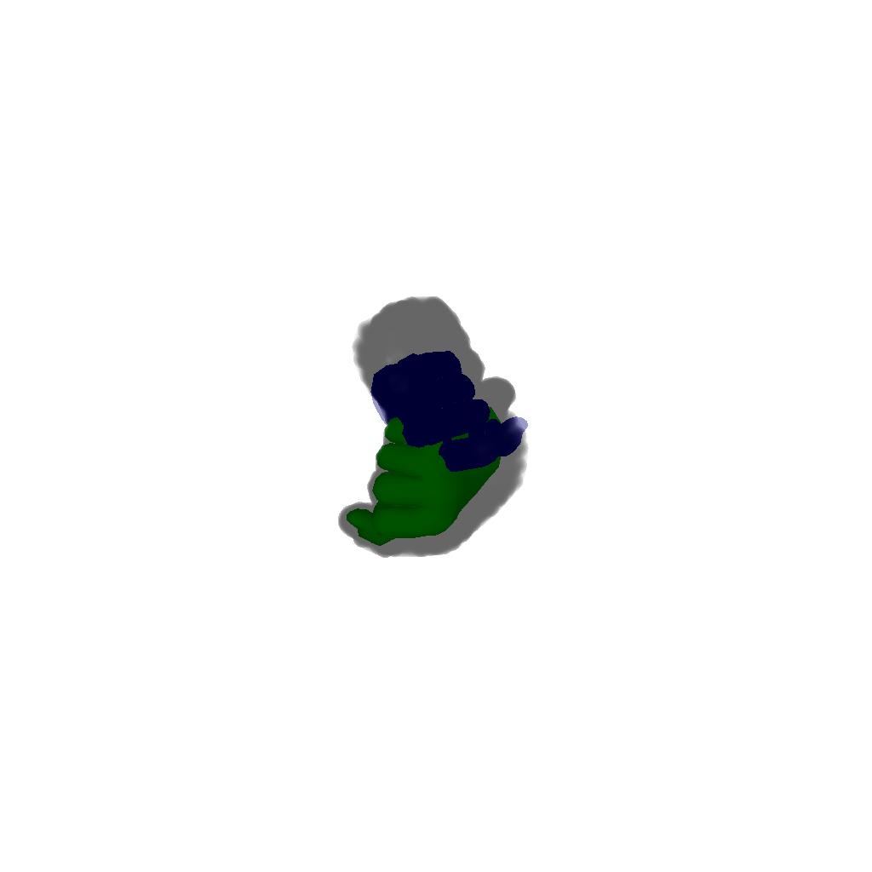
Results
Result 1
Result 2
Failure Case

Slide 11
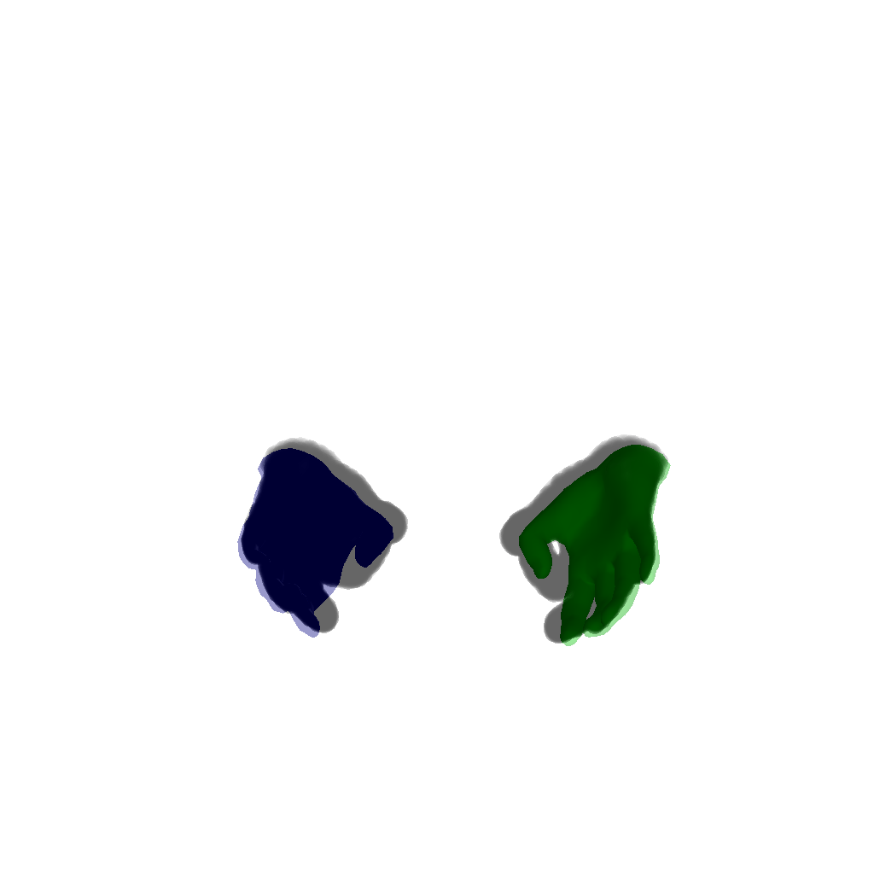
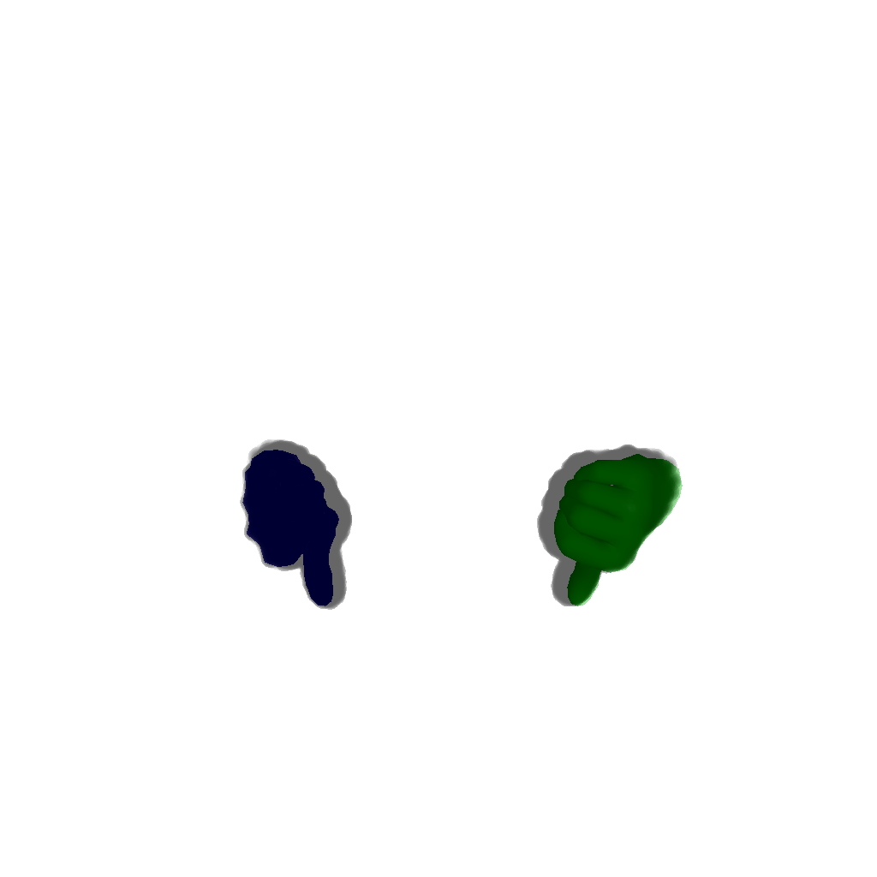
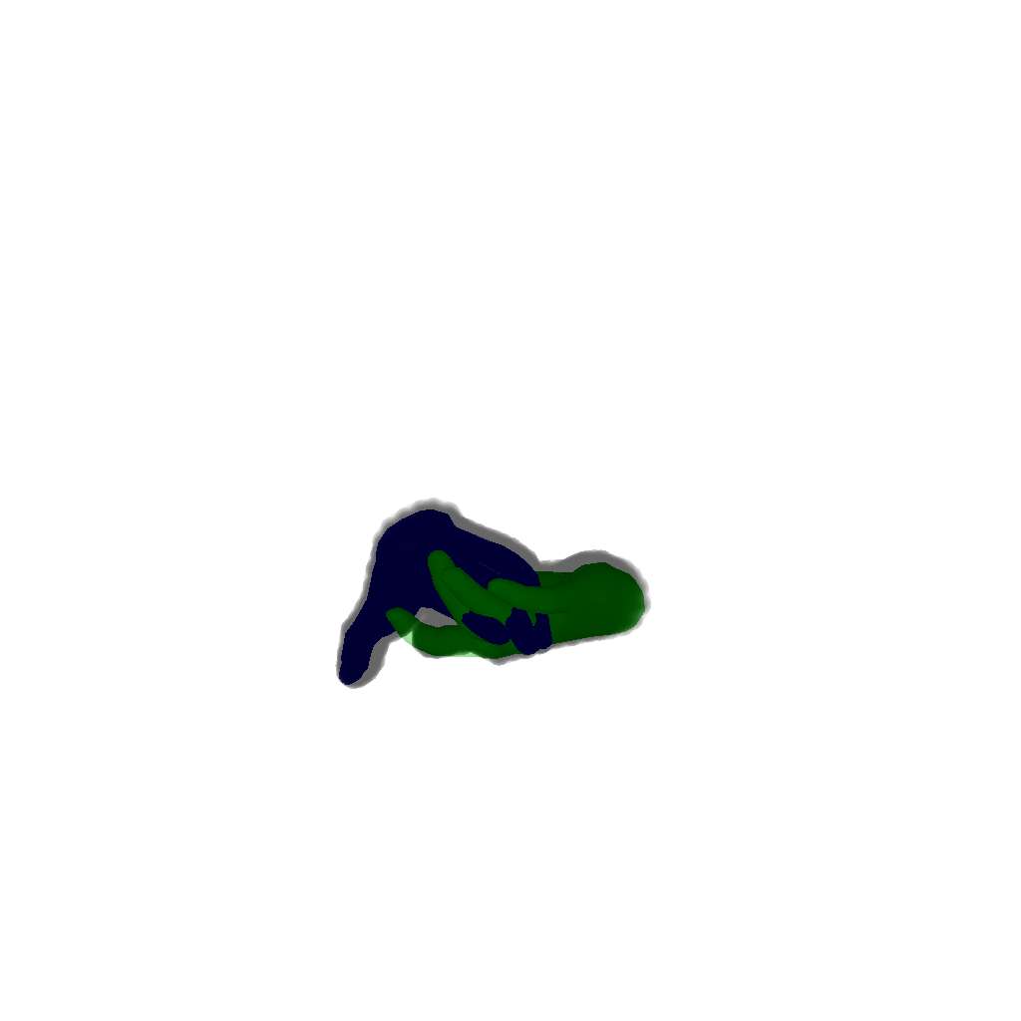
Some more visualizations

Slide 12
Next Steps
Collision Loss: A penetration loss can be used at test time optimization to reduce the collisions observed between the two interacting hands.
Regress MANO Shape Parameter: Model network to predict $β$ to capture variations in hands.
Pose for shadow images in the wild: Predict camera pose along with prediction of MANO parameters.

Slide 13
Thank you!

